Slide 1
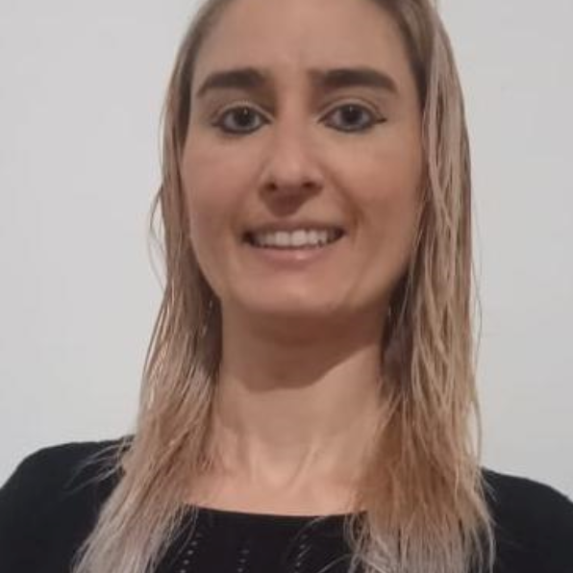
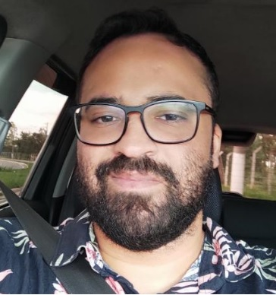
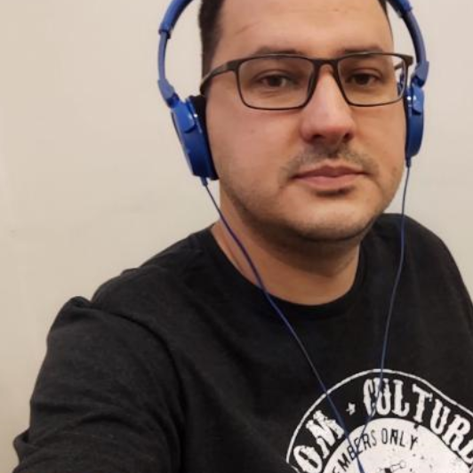
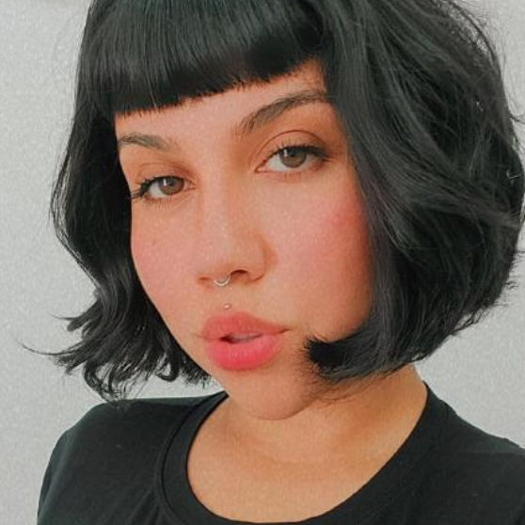

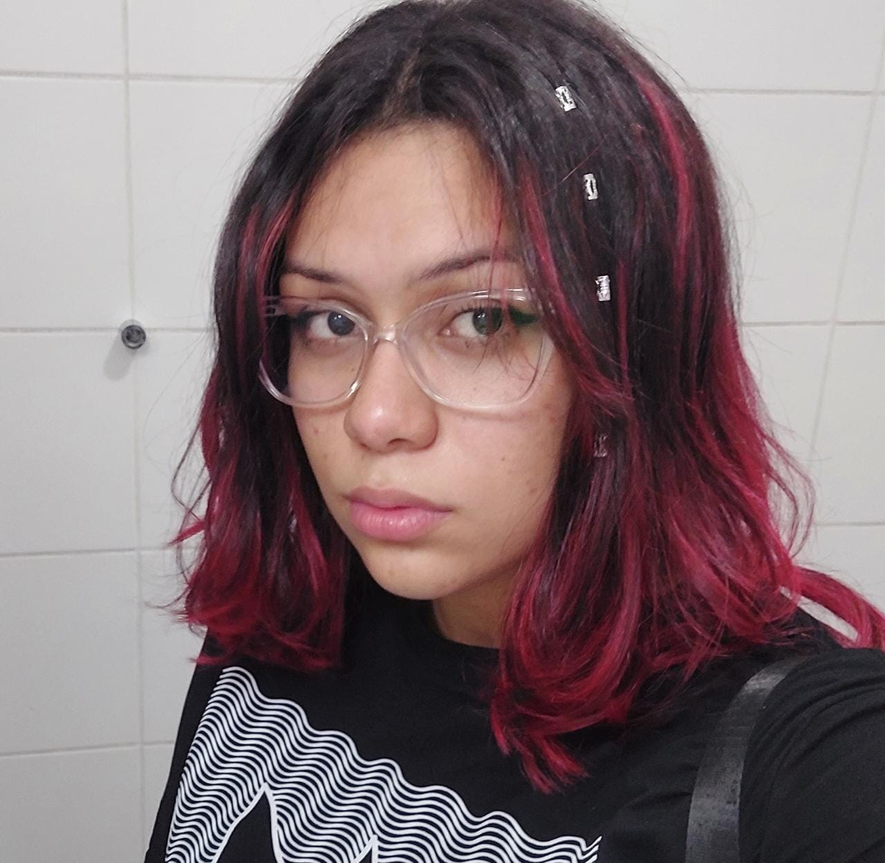
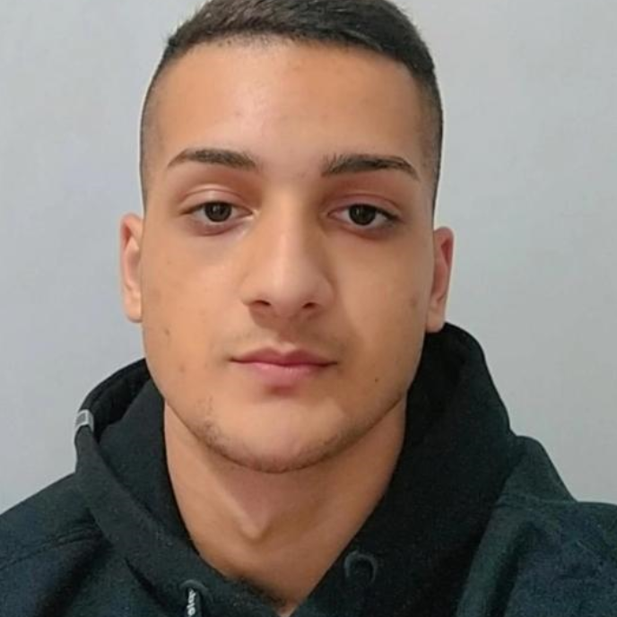
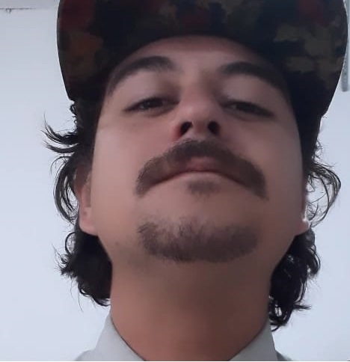
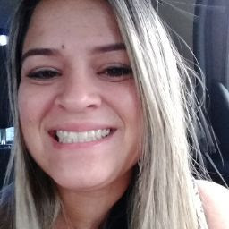
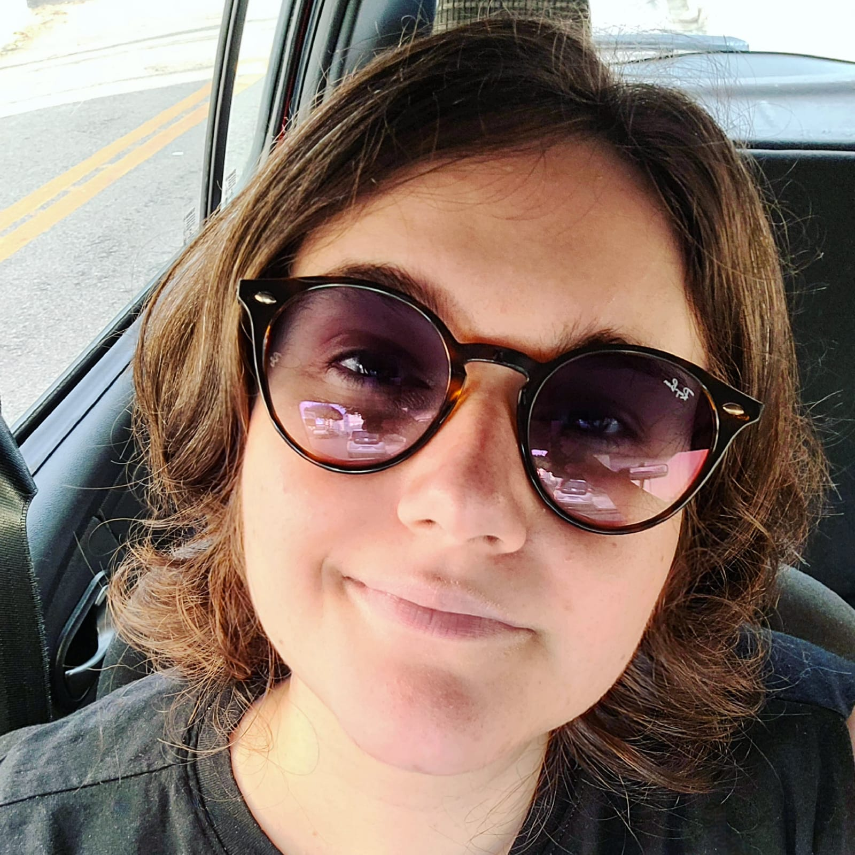
Organograma
DANIELLE
SISMON PO
MATHEUS SANTOS Master Scrum
FERNANDO FERREIRA Dev Team
FRANCIELE CHESERE Dev Team
Antônio Egydeo Graça Product Owner
LARISSA CANDIDO Dev Team
NICOLAS LEMOMS Dev Team
THIAGO NATHAN Dev Team
CLAUDIA NUNES Dev Team
JÉSSICA RILEY Dev Team

